Slide 1

VINTAGE CODER

Slide 2
3
2
1

Slide 10


Slide 11


Slide 12


























Slide 14








Logger (Serilog)
Serilog is a third-party, open-source library that integrates nicely with ASP.NET Core and allows developers to easily log-structured event data to the console, to files, and various kinds of log targets.

Slide 15
OverView
Micro Services
Authentication Service
Event Service
Order Service
API Gateway
Saga Pattern(Data Consistency)
Asynchronous Communication(RabbitMQ Message Broker)
Logger (Serilog)
Testing (XUnit)
Web UI
Microservice
API Gateway
Asynchronous Communication
Logger (Serilog)
Testing (XUnit)

Slide 16



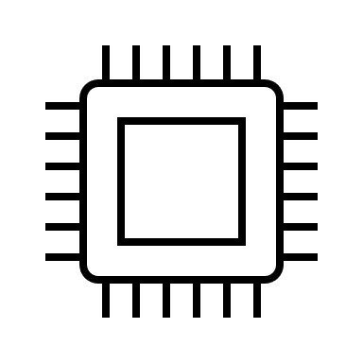





Slide 17





Slide 18













Slide 19



